Slide 1
Exploring the reusability of same Huffman Tree
BY
Praneeth Chandra Thota
pt357
Naveen Narayanan Meyyappan
nm941

Slide 2
Introduction
Most of the applications generate large volumes of data and we need lot of memory to save the data.
Data compression reduces the amount of data that needs to be stored and there by reduces storage costs.
By implementing Huffman encoding on a data set and reusing the same Huffman coding tree for the compression of similar ﬁles we can improve the speed of compression.
Even though this approach may not be optimal, we will still be able to achieve desirable compression at a faster rate.

Slide 3
What is Huffman Encoding?
Huffman Encoding is an algorithm for doing loss less data compression.
Huffman coding assigns codes to characters such that the length of the code depends on the relative frequency of the corresponding character.
Huffman codes are of variable-length, and prefix-free (no code is prefix of any other).
Any prefix-free binary code can be visualized as a binary tree with the encoded characters stored at the leaves.
Huffman tree is a full binary tree in which each leaf of the tree corresponds to a letter in the given alphabet.

Slide 4
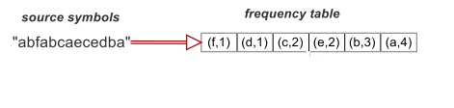
Frequency Table
First step of Huffman encoding is to gather frequencies of all the symbols from the input file.
Generate the frequency table from the frequencies.

Slide 5
Huffman Tree
Build a binary tree called Huffman tree using the frequencies.
The leaf nodes of this tree contains all the frequencies from the frequency table, all the symbols are in the leaf nodes.
All the remaining nodes are the sum of the frequencies of its children nodes.
The tree is build in bottom up approach with the least frequencies at the bottom of the tree.

Slide 6
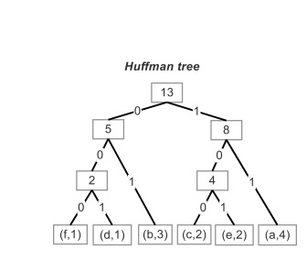
Huffman Tree from frequency table

Slide 7
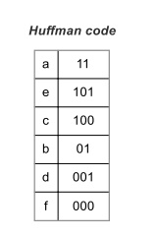
Huffman Code
Generate binary code called Huffman code for every symbol of the file from Huffman tree.

Slide 8
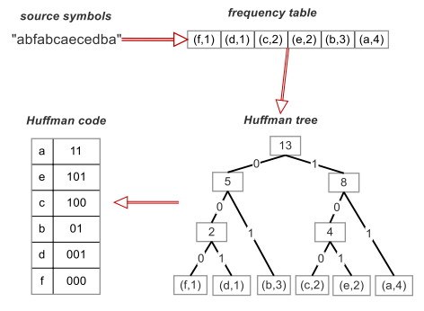
Huffman Encoding Stages

Slide 9
High Level Pseudo Code
Generate frequencies of each symbol from the given data set.
Implement Huffman encoding algorithm on this data.
Generate an encoded tree.
Use this tree to compress ﬁles with similar type

Slide 10
Data Structure Used
Priority queues
Dictionary
Binary tree

Slide 11
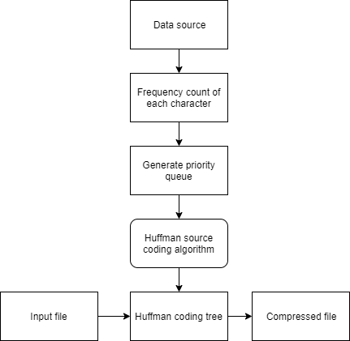
Data Flow Diagram

Slide 12
Code Snippet for Frequency Table
def get_frequency():
frequency = {}
with open("data.txt") as f:
while True:
c = f.read(1)
if not c:
break
frequency[c] = 1 if c not in frequency else frequency[c]+1
return frequency

Slide 13
Code Snippet for Huffman Tree
def build_optimal_merge_tree():
frequencies = get_frequency()
heap = [TreeNode(frequencies[char], char) for char in frequencies]
heapq.heapify(heap)
while len(heap) > 1:
left, right = heapq.heappop(heap), heapq.heappop(heap)
parent = TreeNode(left.val+right.val)
parent.left = left
parent.right = right
heapq.heappush(heap, parent)
return heap[0]

Slide 14
Code Snippet for Huffman Code
def build_encode_table(root):
encode_table = {}
decode_table = {}
stack = [["", root]]
while stack:
code, node = stack.pop(-1)
if node.left:
stack.append([code+'0', node.left])
if node.right:
stack.append([code+'1', node.right])
if not node.left and not node.right:
encode_table[node.char] = code
decode_table[code] = node.char
return encode_table, decode_table

Slide 15
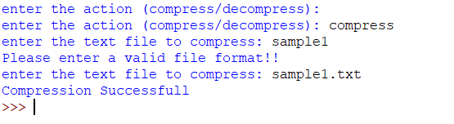

Output

Slide 16
Complexity Analysis
Time Complexity : The conventional Huffman coding algorithm has a run time complexity of O(n log n).
The proposed algorithm takes O(n log n) for first time execution and takes a linear time for next executions.
Space Complexity : The conventional algorithm requires space to maintain the priority queue for each data file. In our case this space is fixed and the stored priority queue does not change.

Slide 17
Challenges
Missing characters, We can overcome this challenge by choosing a data set with wide range of characters involved.
We assume that for each new input at least one new character is identified.
As the number of inputs are increased the character range of tree will also be increased.

Slide 18
Future Extensions
An adaptive approach to the Huffman coding where in a new Huffman coding tree will be generated as when a new character is encountered in the data files.
Creating more than one Huffman coding trees. These trees should have a significant difference in their distributions.
Then we can compress our new file with all the trees and use the tree that gives us less compression ratio.

Slide 19
References
Slide 3 : Techie Delight - https://www.techiedelight.com/huffman-coding/
Slide 3 : http://homes.sice.indiana.edu/yye/lab/teaching/spring2014-C343/huffman.php
Slide 4, 6, 7, 8 : https://www.google.com/url?sa=i&source=images&cd=&cad=rja&uact=8&ved=2ahUKEwimyd_9iozmAhXMneAKHZxhBoMQjB16BAgBEAM&url=http%3A%2F%2Frobotics.cs.tamu.edu%2Fdshell%2Fcs314%2Fsa6%2Fsa6.html&psig=AOvVaw2zgSBE6oP0djit6IwzuKFn&ust=1575002315377572

Slide 20
Thank You

